Slide 1
Spreading Dynamic of a Contagious Disease in Heterogenic Population of living beings with MultiGroup Model Approach
Basuki Widodo
MATHEMATICS DEPARTMENT - FoMaNS
INSTITUT TEKNOLOGI SEPULUH NOPEMBER
INTRODUCTION
EPIDEMIC MODEL OF TWO GROUPS
MODEL EQUILIBIUM POINT
BASIC REPRODUCTION NUMBER
LOCAL EQUILIBRIUM POINT STABILITY
RESULT AND DISCUSSION
CONCLUTION

Slide 2
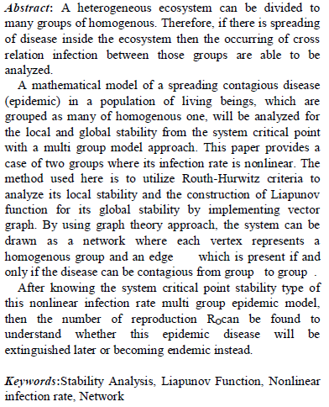
ABSTRACT
Mathematical Modeling
1. INTRODUCTION
ABSTRACT
INTRODUCTION
2. EPIDEMIC MODEL OF
TWO GROUPS
3. MODEL EQUILIBRIUM
POINT
4. BASIC REPRODUCTION
NUMBER
5. Local Equilibrium Point
Stability
6. Discussion and result
7. Conclusion
BACK
NEXT
INTRODUCTION

Slide 3
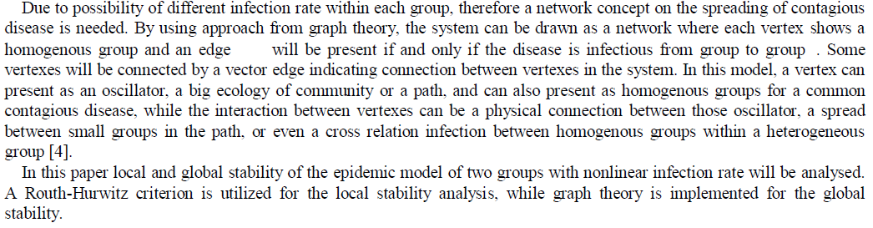
1. INTRODUCTION
SEMINAR HASIL
PENELITIAN
ICMSFM2014
Dalam penelitian terdahulu :
1. INTRODUCTION
1. INTRODUCTION
ABSTRACT
ABSTRACT
INTRODUCTION
INTRODUCTION
2. EPIDEMIC MODEL OF
TWO GROUPS
2. EPIDEMIC MODEL
OF TWO GROUPS
3. MODEL
EQUILIBRIUM POINT
3. MODEL EQUILIBRIUM
POINT
4. . BASIC REPRODUCTION
NUMBER
4. BASIC REPRODUCTION
NUMBER
5. KESTABILAN
5. Local Equilibrium Point
Stability
6. HASIL DAN
DISKUSI
7. KESIMPULAN
6. Discussion and result
DAFTAR PUSTAKA
7. Conclusion
ACCEPTANCE LETTER
BACK
NEXT
EPIDEMIC MODEL of TWO GROUPS

Slide 4
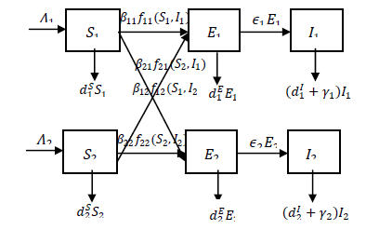
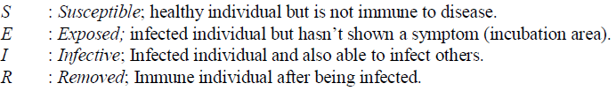
2. Epidemic Model of Two Groups
ICMSFM 2014
2.1 Compartmen Diagram of Epidemic Two Group Model
1. INTRODUCTION
2. EPIDEMIC MODEL of TWO GROUPS
2.1 Compartmen
Diagram of Epidemic
Two Group Model
2.2 Epidemic Model of
Two Groups and the
Solution Area
3. MODEL
EQUILIBRIUM POINT
4. BASIC REPRODUCTION
NUMBER
5. Local Equilibrium
Point Stability
6. Result and
Discussion
7. CONCLUTION
BACK
NEXT
Epidemic Model of Two Groups and the Solution Area

Slide 5
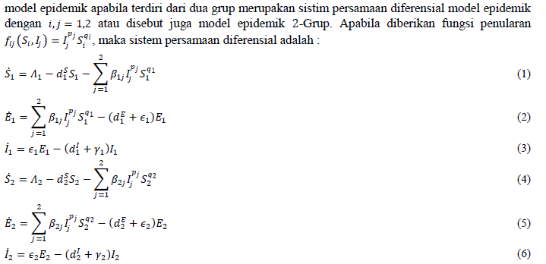
2.2 Epidemic Model of Two Groups and the Solution Area
SEMINAR HASIL
PENELITIAN
ICMSFM 2014
Epidemic model that consist of two groups are differential equation of epidemic model system with or can also be called as epidemic 2-Group. If given the equation of the infection rate , then system of differential equations become :
1. PENDAHULUAN
1. INTRODUCTION
2. MODEL EPIDEMIK DUA GRUP
2. EPIDEMIC MODEL of TWO GROUPS
2.1 Diagram
Kompartemen Model
Epidemik Dua Grup
2.1 Compartmen
Diagram of Epidemic
Two Group Model
2.2 Epidemic Model of Two Groups and the Solution Area
2.2 Epidemic Model of
Two Groups and the
Solution Area
3. TITIK SETIMBANG
MODEL
3. MODEL
EQUILIBRIUM POINT
4. BILANGAN
REPRODUKSI DASAR
4. BASIC REPRODUCTION
NUMBER
5. KESTABILAN
5. Local Equilibrium
Point Stability
6. HASIL DAN
DISKUSI
6. Result and
Discussion
Thus the solutions area of the epidemic two group model can be written as
7. KESIMPULAN
DAFTAR PUSTAKA
7. CONCLUTION
BACK
NEXT
MODEL EQUILIBRIUM POINT

Slide 6





ICMSFM 2014
1. INTRODUCTION
Equilibrium point is a point where it’s characteristic is invariant with time. Then the equilibrium points are taken from
EPIDEMIC MODEL of TWO GROUPS
3. . MODEL
EQUILIBRIUM POINT
and the equation 1 – 6 become:
 | (8)
 | (9)
 | (10)
 | (11)
 | (12)
 | (13)
Disease Free Equilibrium Point
Endemic Equilibrium Point
4. BASIC REPRODUCTION
NUMBER
5. LOCAL EQUILIBRIUM
POINT STABILITY
6. RESULT and DISCUSSION
There are four equilibrium points achieved. They are equilibrium point of disease free, endemic point, a point where first group are disease free while second group are endemic, and a point where first group are endemic while second group are disease free.
7. CONCLUSSION
BACK
NEXT
Disease Free Equilibrium Point

Slide 7


SEMINAR HASIL
PENELITIAN
3.1. Disease Free Equilibrium Point
ICMSFM 2014
.
1. PENDAHULUAN
1. INTRODUCTION
When
, it will have free disease equilibrium point
, where
MODEL EPIDEMIK DUA GRUP
all the individuals are Susceptible or will have no any spread of disease in both of groups. By substituting
EPIDEMIC MODEL of TWO GROUPS
3. TITIK SETIMBANG
MODEL
to equation (10) and (13) will give:
3. MODEL
EQUILIBRIUM POINT
Disease Free Equilibrium Point
And
Disease Free Equilibrium Point
Titik Setimbang Endemik
T Set dmn grup pert bbs pnykt dan grup kedua terj endemik
Endemic Equilibrium Point
This result substituted to equation (8) and (11) resulting
T Set dmn grup pert terj endemik dan grup kedua bbs pnykt
4. BASIC REPRODUCTION
NUMBER
4. BASIC REPRODUCTION
NUMBER
5. LOCAL EQUILIBRIUM
STABILITY
Thus the disease free equilibrium point for this epidemic two group model can be written as
5. LOCAL EQUILIBRIUM
POINT STABILITY
with
6. HASIL DAN DISKUSI
6. RESULT and DISCUSSION
7. KESIMPULAN
7. CONCLUSSION
BACK
NEXT
Endemic Equilibrium Point

Slide 8






3.2
SEMINAR HASIL
PENELITIAN
ICMSFM 2014
Endemic Equilibrium Point
1. PENDAHULUAN
1. INTRODUCTION
Endemic equilibrium point is a condition where the disease will always be inside the population in both of group. Endemic equilibrium point depend on the infected populations from contagious disease with satisfy equations below:
(1)
(2)
(3)
MODEL EPIDEMIK DUA GRUP
EPIDEMIC MODEL of TWO GROUPS
3. TITIK SETIMBANG
MODEL
3. MODEL
EQUILIBRIUM POINT
Titik Setimbang Bebas Penyakit
Disease Free Equilibrium Point
Titik Setimbang Endemik
T Set dmn grup pert bbs pnykt dan grup kedua terj endemik
Endemic Equilibrium Point
T Set dmn grup pert terj endemik dan grup kedua bbs pnykt
4. BILANGAN
REPRODUKSI DASAR
4. BASIC REPRODUCTION
NUMBER
5. KESTABILAN
5. LOCAL EQUILIBRIUM
POINT STABILITY
6. HASIL DAN DISKUSI
7. KESIMPULAN
6. RESULT and DISCUSSION
DAFTAR PUSTAKA
ACCEPTANCE LETTER
7. CONCLUSSION
BACK
NEXT
Basic Reproduction Number

Slide 9



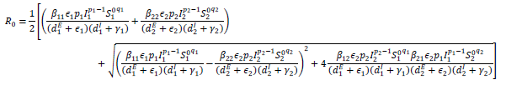
4. Basic Reproduction Number
ICMSFM 2014
.
1. INTRODUCTION
From previous examination, it is known that
EPIDEMIC MODEL of TWO GROUPS
3. MODEL
EQUILIBRIUM POINT
4. BASIC REPRODUCTION
NUMBER
To find
it should be found the Eigen value of the matrix
from equation
will give :
5. LOCAL EQUILIBRIUM
STABILITY
6. RESULT and DISCUSSION
7. CONCLUSSION
Local Equilibrium Point Stability
BACK
NEXT

Slide 10
5. Local Equilibrium Point Stability
ICMSFM 2014
1. INTRODUCTION
EPIDEMIC MODEL of TWO GROUPS
Consisting :
5.1. Local Equilibrium Point Stability of Free Disease Condition
5.2. Local Equilibrium Point of Both Groups Are Endemic
5.3. Local Point Stability of the First Group is Free Disease and the
Second Group is Endemic.
5.4. Local Stability of First Group Endemic and Second Group Free
Disease
3. MODEL
EQUILIBRIUM POINT
4. BASIC REPRODUCTION
NUMBER
5. LOCAL EQUILIBRIUM
POINT STABILITY
Local Equilibrium Point Stability of Free Disease Condition
Local Equilibrium Point of Both Groups Are Endemic
Rout - Hurwitz Table
6. RESULT and DISCUSSION
7. CONCLUSSION
Local Equilibrium Point Stability of Free Disease Condition
BACK
NEXT

Slide 11

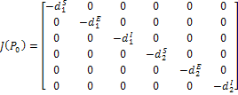
5.1. Local Equilibrium Point Stability of Free Disease Condition
ICMSFM 2014
1. INTRODUCTION
EPIDEMIC MODEL of TWO GROUPS
On the free disease equilibrium point
with
3. MODEL
EQUILIBRIUM POINT
it is known that
4. BASIC REPRODUCTION
NUMBER
so then its Jacobian matrix:
5. LOCAL EQUILIBRIUM
POINT STABILITY
Local Equilibrium Point Stability of Free Disease Condition
The Eigen value can be taken from
Local Equilibrium Point of Both Groups Are Endemic
Due to Eigen value of
are negative on the real components, therefore the equilibrium point
Rout - Hurwitz Table
is asymptotic stable.
6. RESULT and DISCUSSION
7. CONCLUSSION
Local Equilibrium Point of
Both Groups Are Endemic
BACK
NEXT

Slide 12
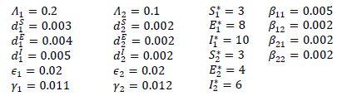
5.2. Local Equilibrium Point of Both Groups Are Endemic
ICMSFM 2014
1. INTRODUCTION
EPIDEMIC MODEL of TWO GROUPS
On the equilibrium point of
3. MODEL
EQUILIBRIUM POINT
both groups are on endemic condition.
Then it should be found
. Resulting characteristic equation with model of
4. BASIC REPRODUCTION
NUMBER
To know the stability of that equilibrium point, a parameter will
be chosen to refer to the solution area as below:
5. LOCAL EQUILIBRIUM
POINT STABILITY
Local Equilibrium Point Stability of Free Disease Condition
Local Equilibrium Point of Both Groups Are Endemic
Rout - Hurwitz Table
By inputting that value to characteristic equation, will result:
6. RESULT and DISCUSSION
7. CONCLUSSION
Routh – Hurwitz Table
BACK
NEXT

Slide 13
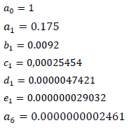




ICMSFM 2014
1. INTRODUCTION
EPIDEMIC MODEL of TWO GROUPS
3. MODEL
EQUILIBRIUM POINT
Then Routh-Hurwitz criterion stability is used to analyze the stability of
the endemic equilibrium point.
4. BASIC REPRODUCTION
NUMBER
5. LOCAL EQUILIBRIUM
POINT STABILITY
Local Equilibrium Point Stability of Free Disease Condition
Local Equilibrium Point of Both Groups Are Endemic
Rout - Hurwitz Table
6. RESULT and DISCUSSION
It is shown that values on the first column have the same sign, positive
numbers, so then the stability of the equilibrium point
7. CONCLUSSION
is local asymptotic stable.
Result and Discussion
BACK
NEXT

Slide 14
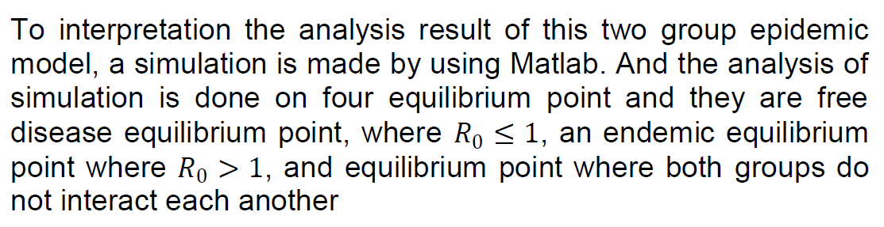
ICMSFM 2014
6. RESULT AND DISCUSSION
1. INTRODUCTION
EPIDEMIC MODEL of TWO GROUPS
3. MODEL
EQUILIBRIUM POINT
4. BASIC REPRODUCTION
NUMBER
5. LOCAL EQUILIBRIUM
POINT STABILITY
6. RESULT and DISCUSSION
Free Desease Condition
Endemic Condition (Ro > 1)
7. CONCLUSSION
Free Desease Condition
BACK
BACK
NEXT
NEXT

Slide 15
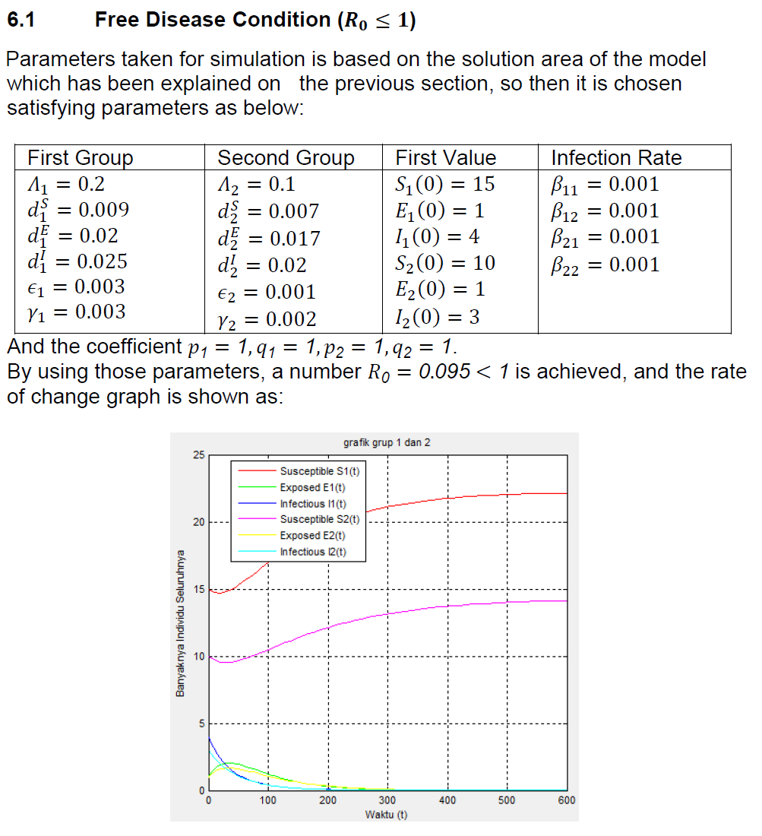
ICMSFM 2014
1. INTRODUCTION
EPIDEMIC MODEL of TWO GROUPS
3. MODEL
EQUILIBRIUM POINT
4. BASIC REPRODUCTION
NUMBER
5. LOCAL EQUILIBRIUM
POINT STABILITY
6. RESULT and DISCUSSION
Free Desease Condition
Endemic Condition (Ro > 1)
7. CONCLUSSION
BACK
Free Desease Condition
BACK
NEXT
NEXT

Slide 16
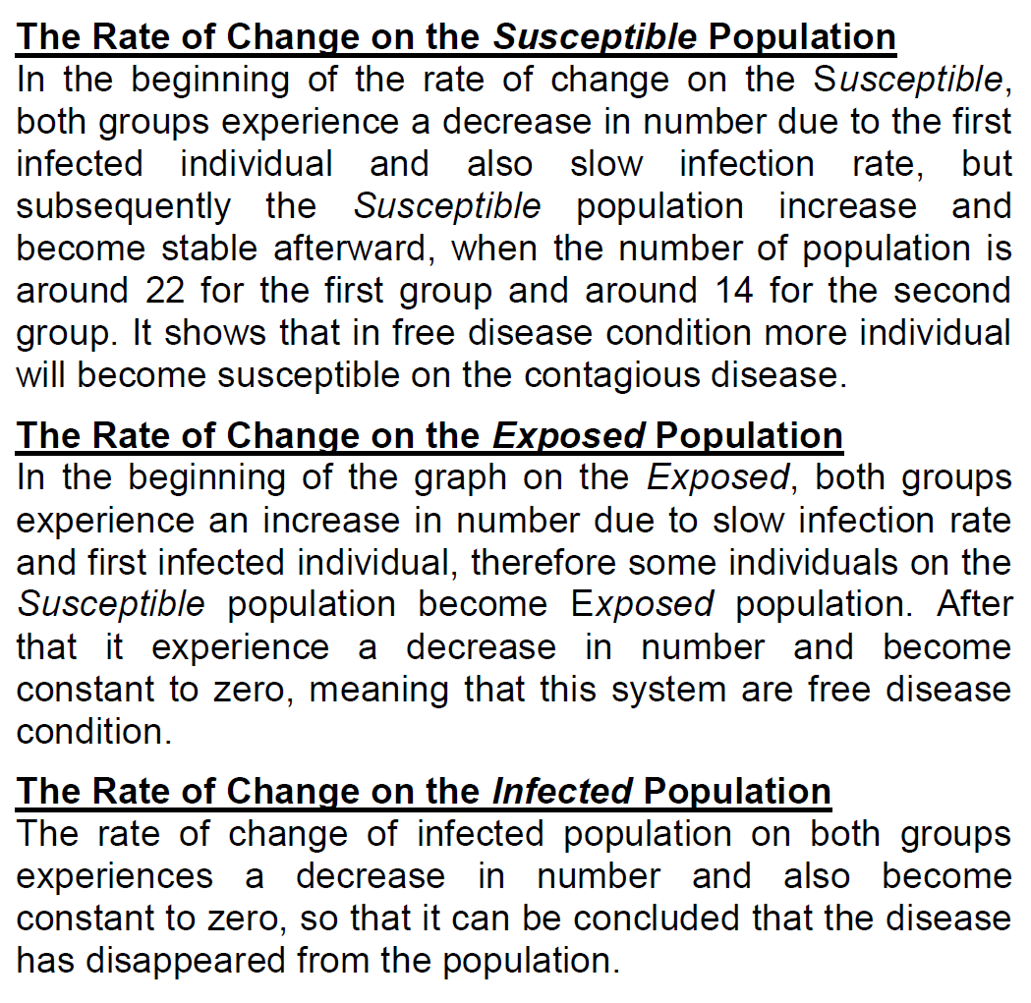
ICMSFM 2014
1. INTRODUCTION
EPIDEMIC MODEL of TWO GROUPS
3. MODEL
EQUILIBRIUM POINT
4. BASIC REPRODUCTION
NUMBER
5. LOCAL EQUILIBRIUM
POINT STABILITY
6. RESULT and DISCUSSION
Free Desease Condition
Endemic Condition (Ro > 1)
7. CONCLUSSION
Endemic Condition (Ro > 1)
BACK
NEXT

Slide 17
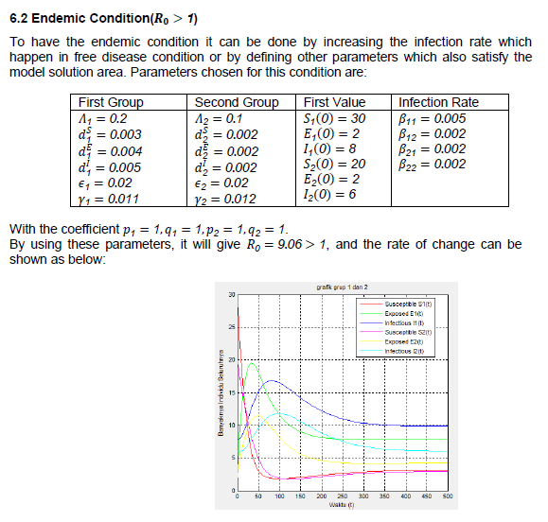
ICMSFM 2014
1. INTRODUCTION
EPIDEMIC MODEL of TWO GROUPS
3. MODEL
EQUILIBRIUM POINT
4. BASIC REPRODUCTION
NUMBER
5. LOCAL EQUILIBRIUM
POINT STABILITY
6. RESULT and DISCUSSION
Free Desease Condition
Endemic Condition (Ro > 1)
7. CONCLUSSION
Endemic Condition (Ro > 1)
BACK
NEXT

Slide 18
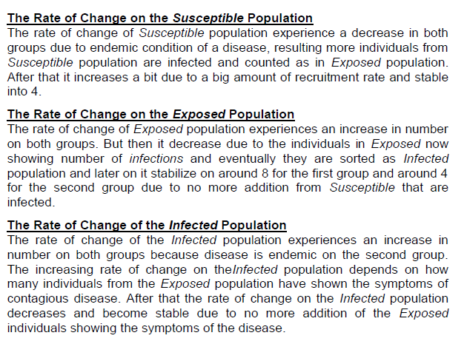
ICMSFM 2014
1. INTRODUCTION
EPIDEMIC MODEL of TWO GROUPS
3. MODEL
EQUILIBRIUM POINT
4. BASIC REPRODUCTION
NUMBER
5. LOCAL EQUILIBRIUM
POINT STABILITY
6. RESULT and DISCUSSION
Free Desease Condition
Endemic Condition (Ro > 1)
7. CONCLUSSION
CONCLUSION
BACK
NEXT

Slide 19
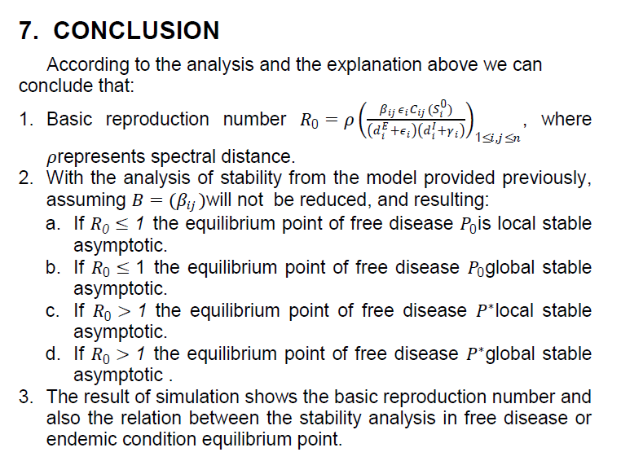
SEMINAR HASIL
PENELITIAN
1. PENDAHULUAN
MODEL EPIDEMIK DUA GRUP
3. TITIK SETIMBANG
MODEL
4. BILANGAN
REPRODUKSI DASAR
5. KESTABILAN
6. HASIL DAN DISKUSI
7. KESIMPULAN
DAFTAR PUSTAKA
THANK YOU
BACK
BACK
NEXT
NEXT

Slide 20
ICMSFM 2014
THANK YOU
1. INTRODUCTION
EPIDEMIC MODEL of TWO GROUPS
3. MODEL
EQUILIBRIUM POINT
4. BASIC REPRODUCTION
NUMBER
5. LOCAL EQUILIBRIUM
POINT STABILITY
6. RESULT and DISCUSSION
7. CONCLUSSION
BACK
NEXT

